Slide 1

Fraud Detection
Model & drift monitoring

Slide 2
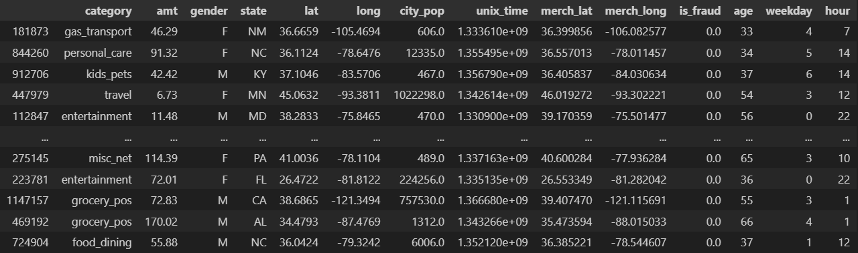
Data & Preprocessing
Pre-processed data

Slide 3
Data & Preprocessing
- Only structured data columns (categorical and numerical) are included. This is motivated by our eventual choice of using XGBoost, which works primarily on tabular data.
- Unstructured text columns like addresses and job titles are not included. While such data may be included in a more comprehensive deep learning model that includes text encoders like BERT, we will see that XGBoost on only structured data performs quite well.
- Timestamps and dates-of-birth are not included, but handcrafted features such as day of the week and hour of day are included.

Slide 4
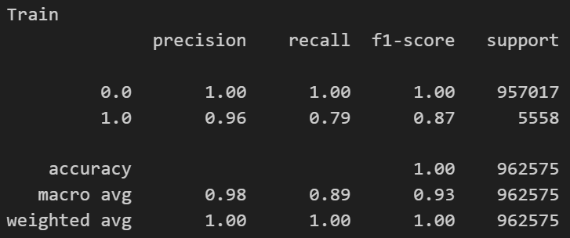
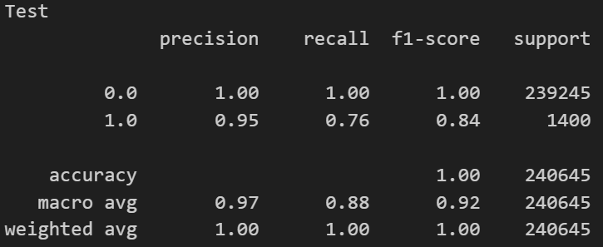
Model Performance
Train
Test

Slide 5
Drift Detection
Covariate & prior drift
Concept Drift
These sources of drift may be detected by doing feature-wise Chi-Square tests and Kolmogorov-Smirnov tests on tabular data. Since this involves multiple hypothesis testing, false rejections of null (no association) may be accounted for using methods like Bonferroni correction.
This may be detected using newly labelled ground truth data for evaluation on metrics such as precision, recall and accuracy.
If the model deteriorates in these metrics, there may be concept drift.

Slide 6
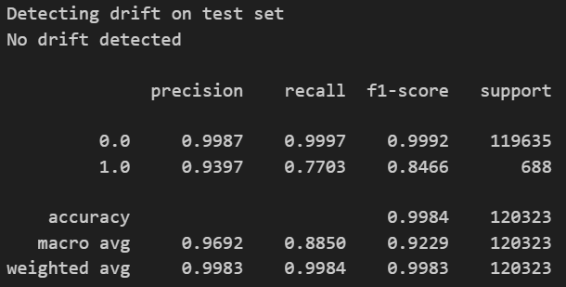
Covariate & Prior Drift
Drift detection can be done while new data arrives in batches.
As example, we expect the train and test splits to not have a drift. Thus, our drift detector should not identify drift in the test set.
The model performance is similar to the train set.

Slide 7
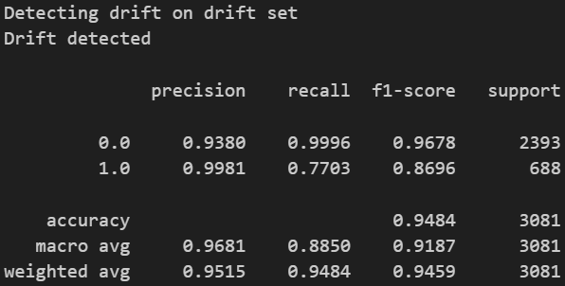
Covariate & Prior Drift
However, if we artificially induce drift (specifically, prior drift) by sampling all positive cases and only 2% of negative cases, we should detect drift.
We can also see that precision scores for negative cases has deteriorated.

